Slide 1

Reliable Change Point Detection for ACGH data
Eliades Charalambos, Harris Papadopoulos

Slide 2
Outline
Motivation
Change Point
Inductive Conformal Martingales
Betting Functions
CP Detection
Experiments and Results
Conclusions and Future Work

Slide 3
Need for a Robust, Assumption-Free Detection Method
Understanding Genetic Variations: Genomics is pivotal in uncovering the genetic basis of diseases and developing personalized medicine.
Significance in Cancer Research: Detecting genomic gains and losses through aCGH data is crucial for identifying cancer biomarkers and therapeutic targets.
Challenges in Detection: Traditional change point detection methods often rely on assumptions that may not hold for complex genomic data, leading to potential inaccuracies.

Slide 4
Change Point Detection with Inductive Conformal Martingales
Limitations of Current Methods: Existing methods often require extensive computational resources and are prone to errors if underlying assumptions about data distribution are incorrect.
ICM Approach: Our research uses Inductive Conformal Martingales method that operates without assuming any distribution.

Slide 5
Change Points in aCGH data
Definition of Change Point: A 'change point' refers to a location in the genomic sequence at which the statistical properties of the sequence data, undergo a significant change.
Relevance in Genomics: In the context of aCGH data, change points can indicate crucial alterations in DNA, such as gains or losses of genomic material, which are essential for diagnosing various genetic conditions.
Detection Challenge: Identifying the precise locations of these changes is critical for interpreting aCGH data and understanding the underlying genetic changes in an organism.
.

Slide 6
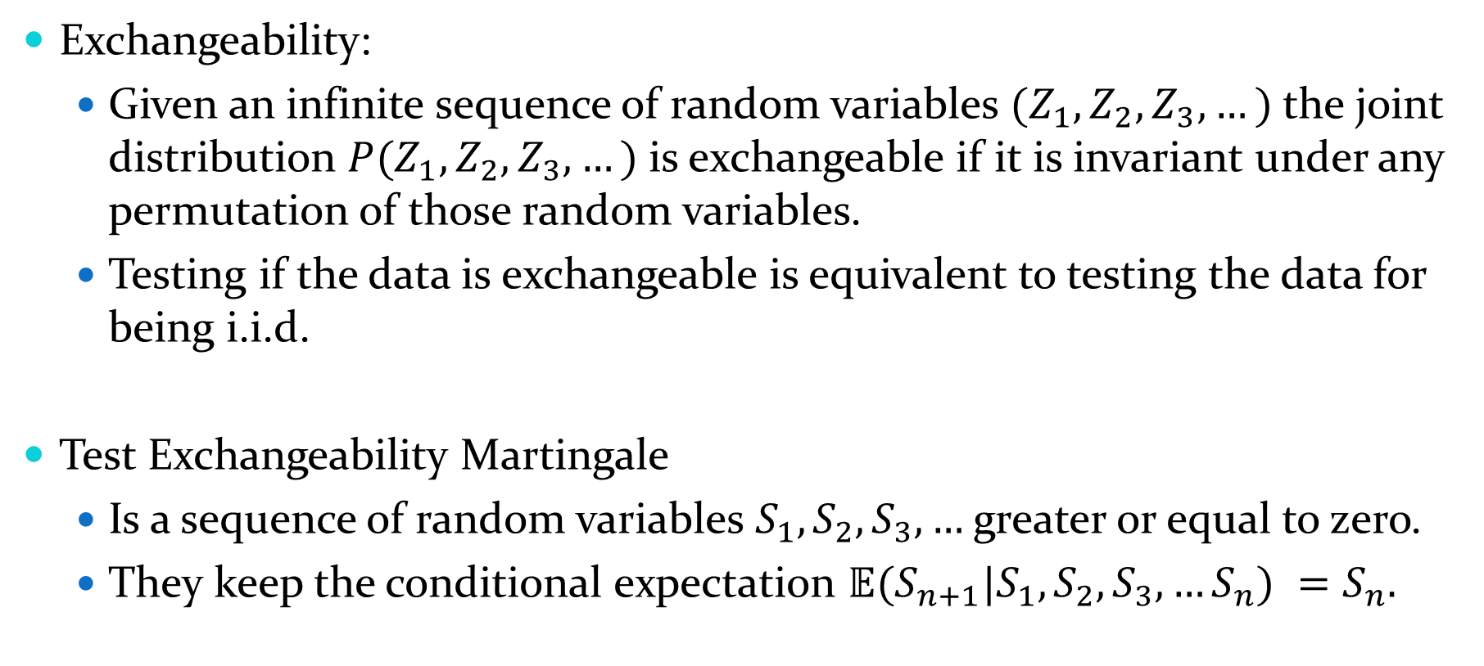
Data Exchangeability
Exchangeability:
  Given an infinite sequence of random variables $(Z_{1},Z_{2},Z_{3},…)$the joint distribution $P(Z_{1},Z_{2},Z_{3},…)$is exchangeable if it is invariant under any permutation of those random variables.
  Testing if the data is exchangeable is equivalent to testing the data for being i.i.d.
Test Exchangeability Martingale
  Is a sequence of random variables $S_{1},S_{2},S_{3},…$ greater or equal to zero.
  They keep the conditional expectation $𝔼(S_{n+1}|S_{1},S_{2},S_{3},…S_{n}) =S_{n}.$

Slide 7

The Role of Martingales in Fair Gambling
Fair Game and Infinite Wealth Scenario
Martingale as a Measure of Gains
Ville's Inequality
  $ℙ\left({∃n,S}_{n}≥C\right)≤1/C$

Slide 8
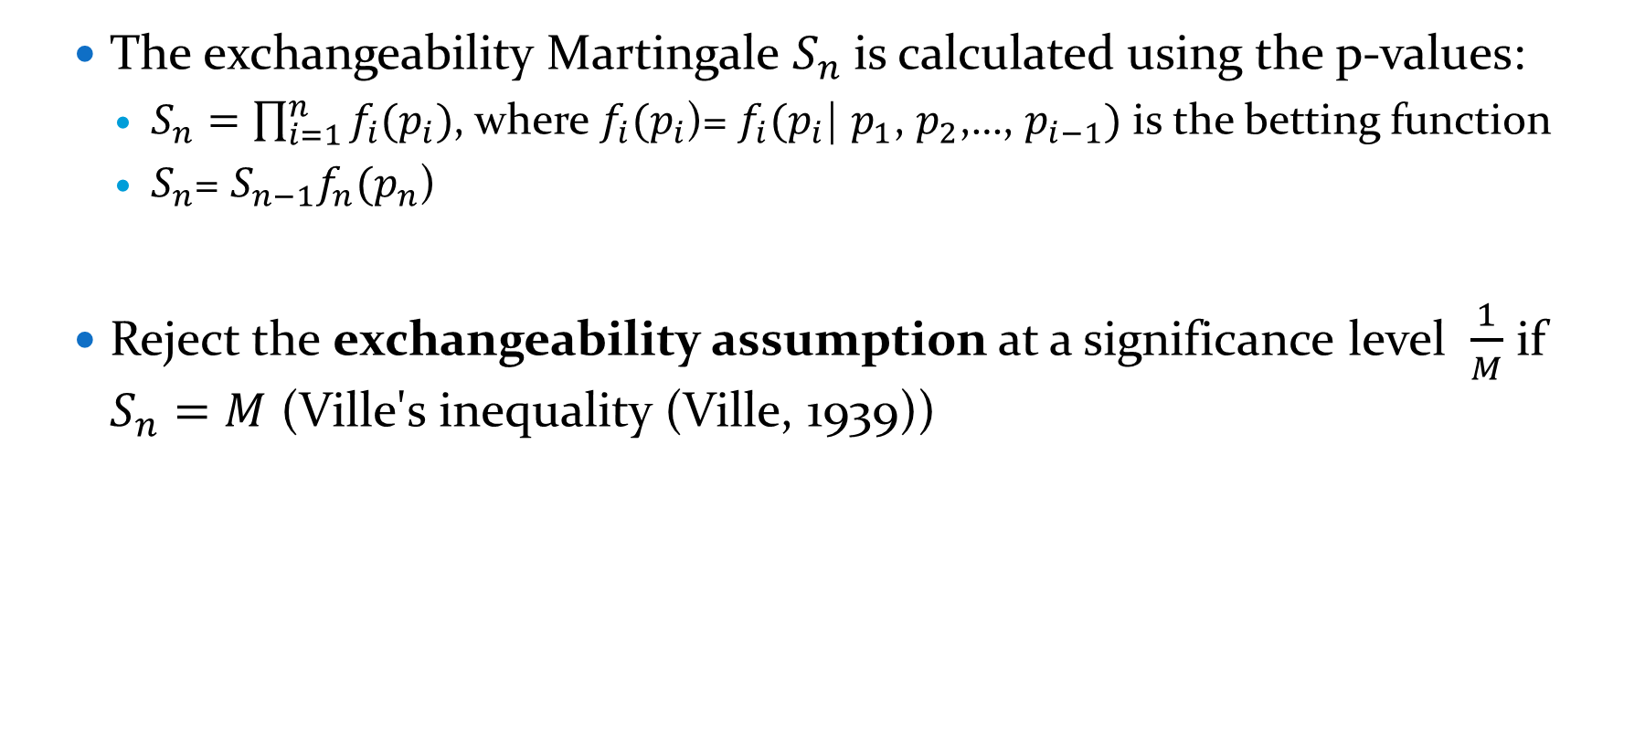
Conformal Martingales
  The exchangeability Martingale $S_{n}$is calculated using the p-values:
    $S_{n}=\prod_{i=1}^{n}{f_{i}(p_{i})}$, where $f_{i}(p_{i}$)= $f_{i}(p_{i}$| $p_{1}$, $p_{2}$,…, $p_{i−1})$ is the betting function
    $S_{n}$= $S_{n−1}f_{n}(p_{n}\text{)}$
  Reject the exchangeability assumption at a significance level $\frac{1}{M}$ if $S_{n}=M$ (Ville's inequality (Ville, 1939))

Slide 9
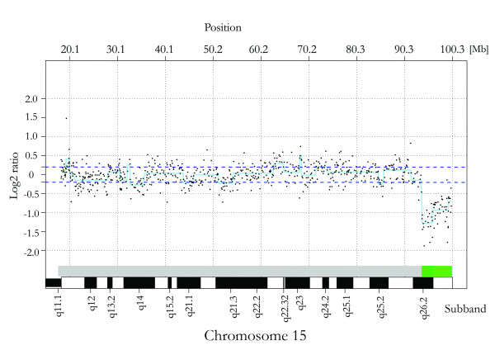
ACGH Data
Davidsson, Josef & Collin, Anna & Björkhem, Gudrun & Soller, Maria. (2008). Array based characterization of a terminal deletion involving chromosome subband 15q26.2: An emerging syndrome associated with growth retardation, cardiac defects and developmental delay. BMC medical genetics. 9. 2. 10.1186/1471-2350-9-2.

Slide 10
Nonconformity Measure
No Underlying Algorithm
NCM: Identity after we preprocessed the data.
Preprocessing
  Missing Values
  Outlier Removal
  Median Filtering
  Data Normalization
  Absolute Value and define labels according to sign(Gains, Losses)

Slide 11
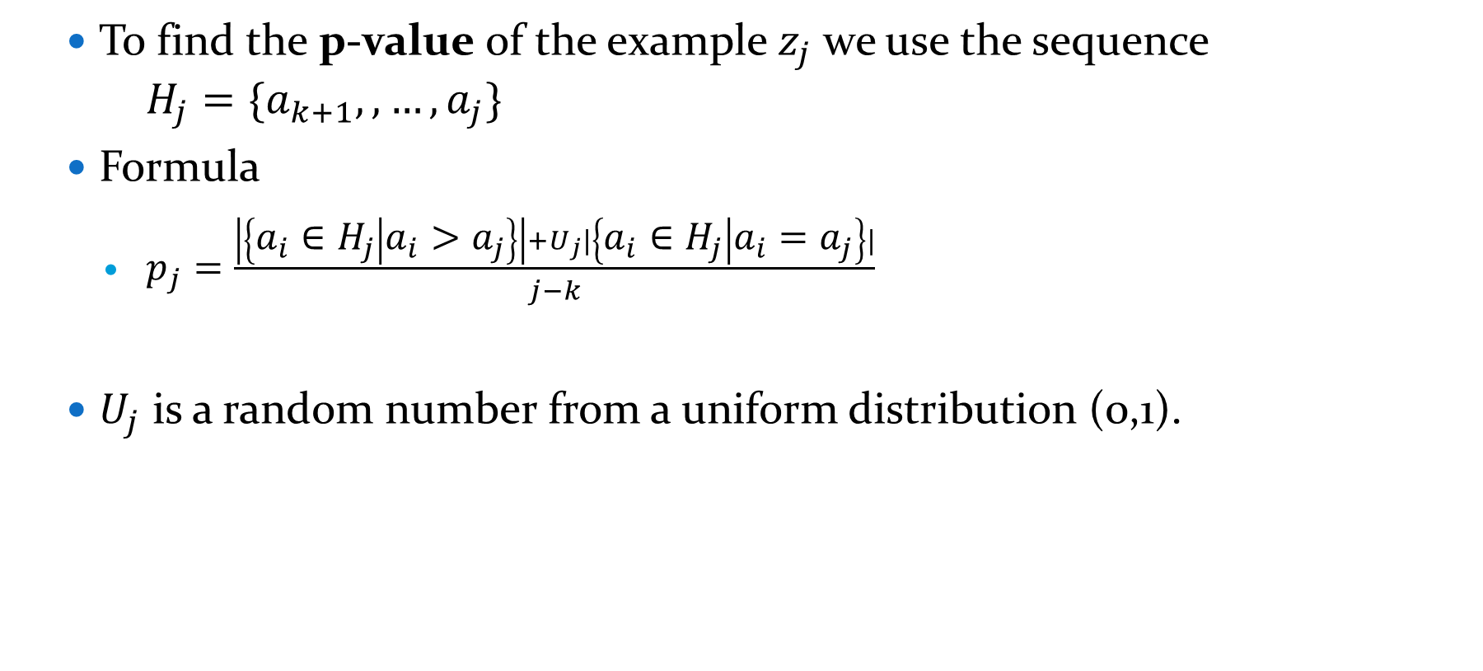
P-value Calculation
  To find the p-value of the example $z_{j}$ we use the sequence $H_{j}=\{a_{k+1},, …,a_{j}\}$
  Formula
    $p_{j}=\frac{\left|\left\{a_{i}∈H_{j} | a_{i}>a_{j}\right\}\right|+U_{j}|\left\{a_{i}∈H_{j} | a_{i}=a_{j}\right\}|}{j−k}$
  $U_{j}$ is a random number from a uniform distribution (0,1).

Slide 12
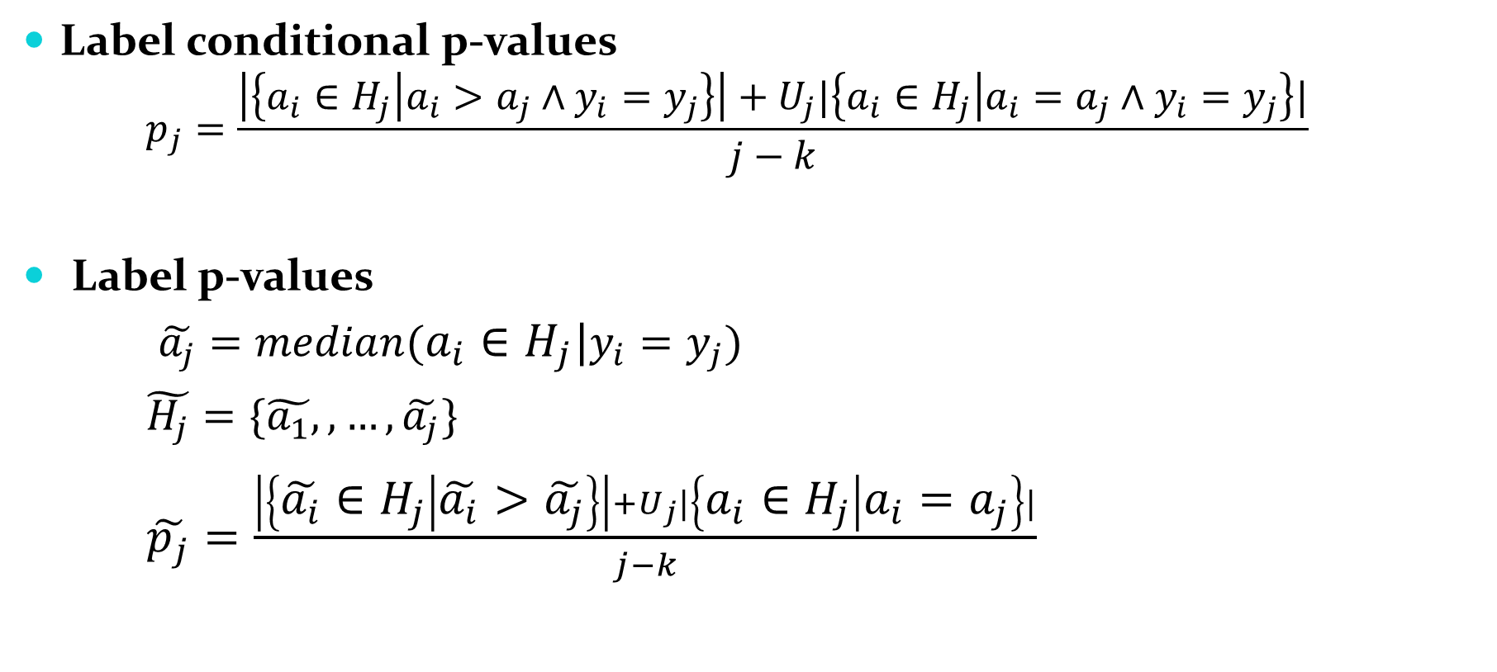
P-value Calculation
Label conditional p-values
  $$p_{j}=\frac{\left|\left\{a_{i}∈H_{j} | a_{i}>a_{j}∧y_{i}=y_{j}\right\}\right|+U_{j}|\left\{a_{i}∈H_{j} | a_{i}=a_{j}∧y_{i}=y_{j}\right\}|}{j−k}$$
Label p-values
$\tilde{a_{j}}=median(a_{i}∈H_{j}|y_{i}=y_{j})$
$\tilde{H_{j}}=\{\tilde{a_{1}},, …,\tilde{a_{j}}\}$
$\tilde{p_{j}}=\frac{\left|\left\{\tilde{a_{i}}∈H_{j} | \tilde{a_{i}}>\tilde{a_{j}}\right\}\right|+U_{j}|\left\{a_{i}∈H_{j} | a_{i}=a_{j}\right\}|}{j−k}$

Slide 13
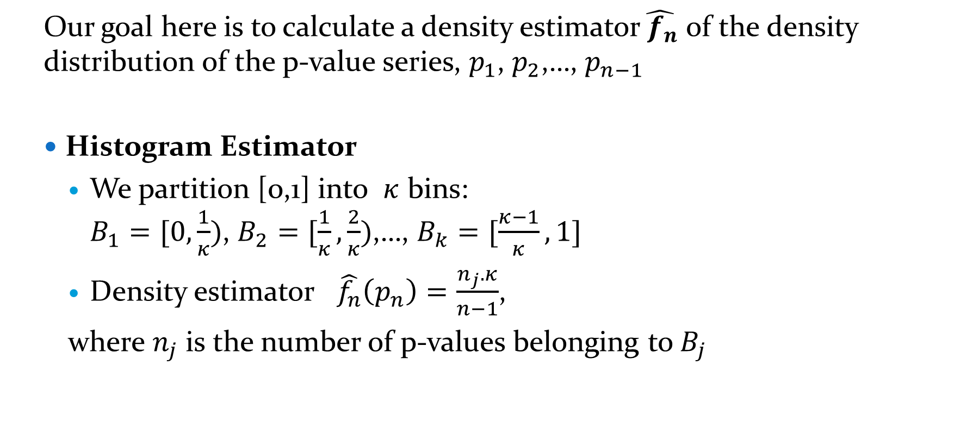
Histogram Estimator as a Betting Function
  Our goal here is to calculate a density estimator$\hat{{ f}_{n}}$ of the density distribution of the p-value series, $p_{1}$, $p_{2}$,…, $p_{n−1}$
  Histogram Estimator
    We partition [0,1] into $κ$ bins: $B_{1}=[0,\frac{1}{κ})$, $B_{2}=[\frac{1}{κ},\frac{2}{κ})$,…, $B_{k}=[\frac{κ−1}{κ},1]$
    Density estimator $\hat{f_{n}}\left(p_{n}\right)=\frac{n_{j}.κ}{n−1}$,
    where $n_{j}$ is the number of p-values belonging to $B_{j}$

Slide 14

Kernel Estimator as a Betting Function
  Kernel estimator
    $\hat{f_{n}}\left(x\right)=\frac{1}{nh}\sum_{i=i}^{n}{K(\frac{x−x_{i}}{h})}$
    Where K(z)=$\frac{1}{\sqrt{2π}}e^{−\frac{z^{2}}{2}}$
    h is the bandwidth.

Slide 15

The Cautious Betting Function
Cautious Betting Function: $h_{n}$= $\left\{\begin{aligned}1 if\frac{{S1}_{n−1}}{min{S1}_{n−k}}≤ε \\ f_{n} if\frac{{S1}_{n−1}}{min{S1}_{n−k}}>ε\end{aligned}\right.$
${With S1}_{n−k}=\prod_{i=1}^{n}{f_{i}(p_{i})} ,ε>0 k∈\{n−w,…,n−1\}$ and w is an integer

Slide 16
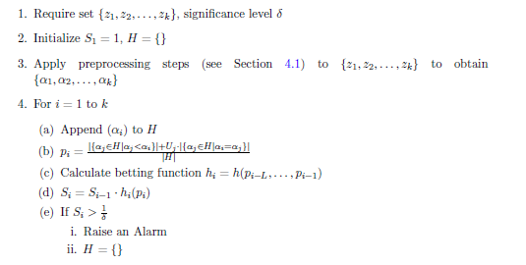
CP detection with ICM Alg1
Now if the final value of the Martingale $S_{i}$ exceeds 10 or 100 then we can reject the exchangeability assumption at a significance level equal to 10% and 1% respectively, thus an alarm is raised for CD detection.

Slide 17
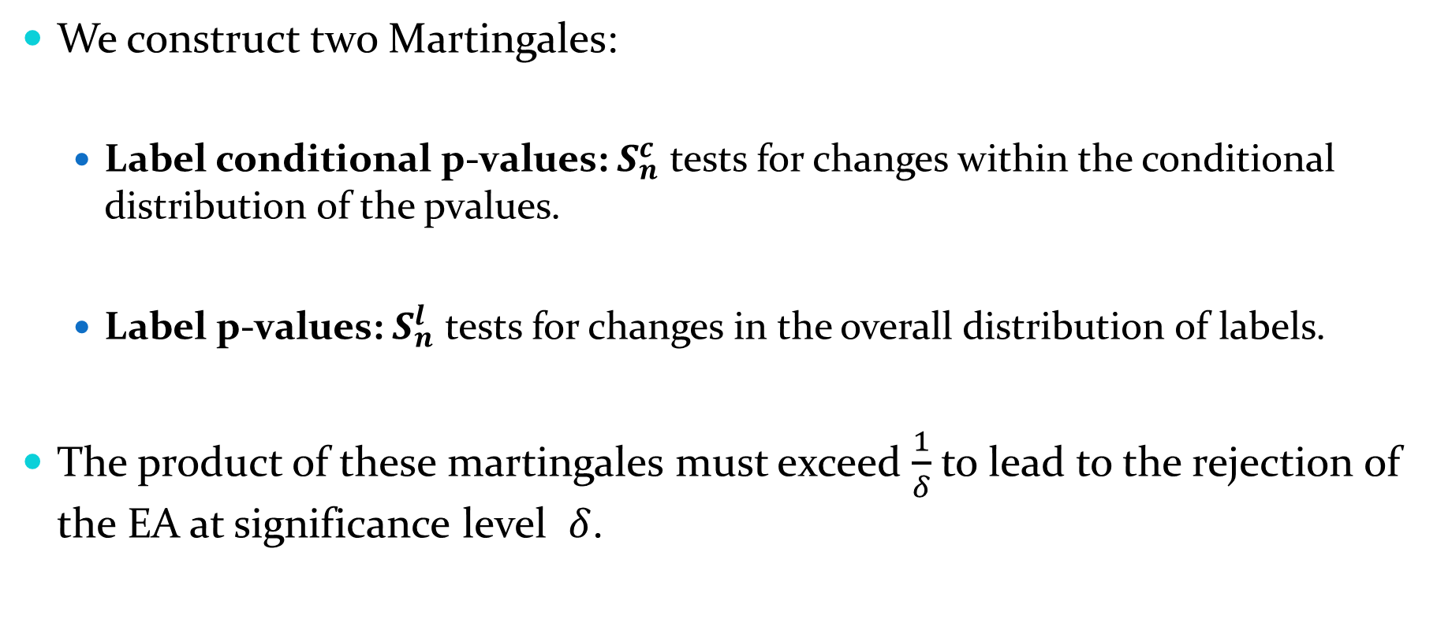
ICM alg2
We construct two Martingales:
  Label conditional p-values: $S_{n}^{c}$ tests for changes within the conditional distribution of the pvalues.
  Label p-values: $S_{n}^{l}$ tests for changes in the overall distribution of labels.
The product of these martingales must exceed $\frac{1}{δ}$to lead to the rejection of the EA at significance level $δ$.

Slide 18
CP detection with ICM Alg2

Slide 19
Experiments and results - Dataset
  ACGH Dataset contains data from 57 patients with bladder tumor.
  It features the log2 ratio of DNA quantities between tumorous cells and a healthy reference.
  A negative log2 ratio indicates losses in the genomic sequence, while a positive log2 ratio implies gains
  We Remove all NaNs and outliers.
  We also omit chromosomes associated with gender from this analysis.

Slide 20
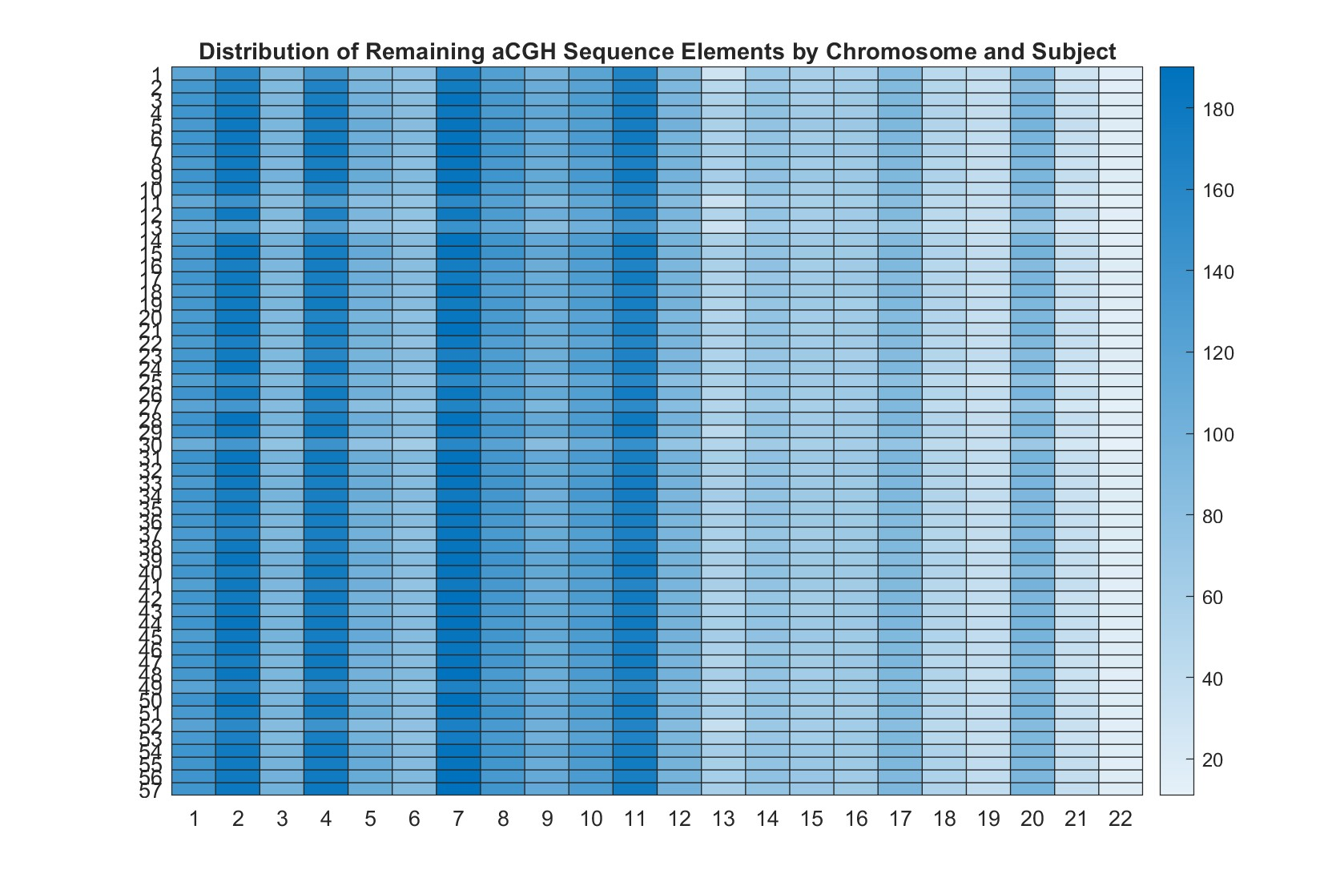

Slide 21
Experiments and results
Performance measure
  Number of change points per subject

Slide 22
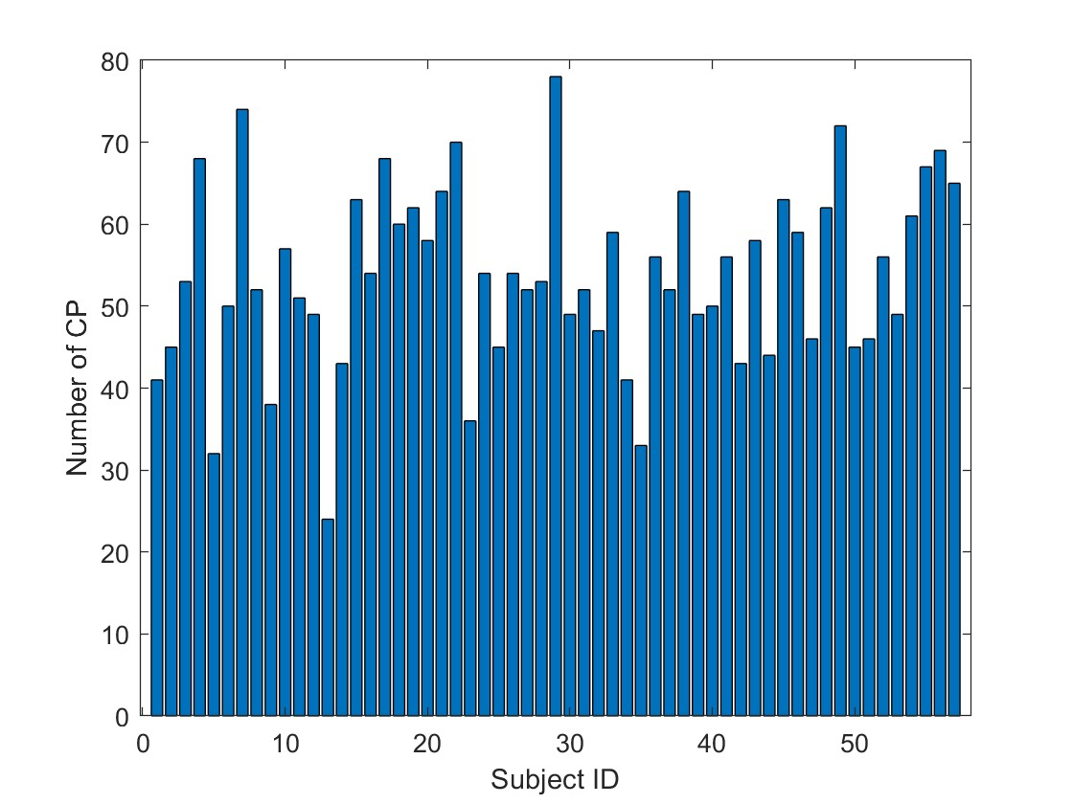
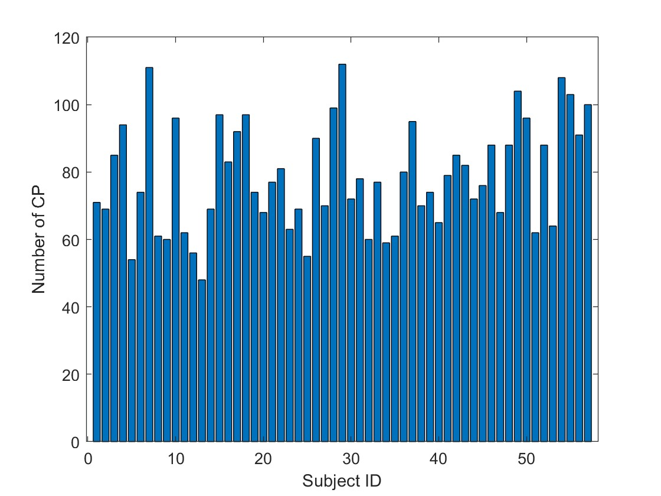
Cautious-Kernel alg1 vs alg2

Slide 23
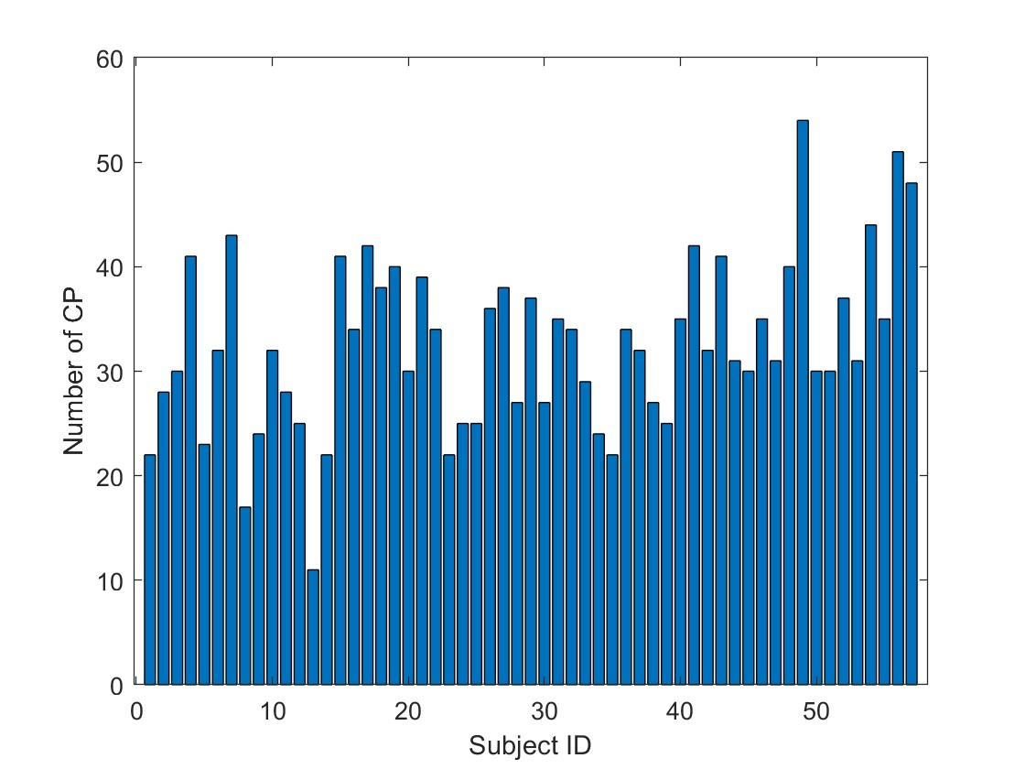
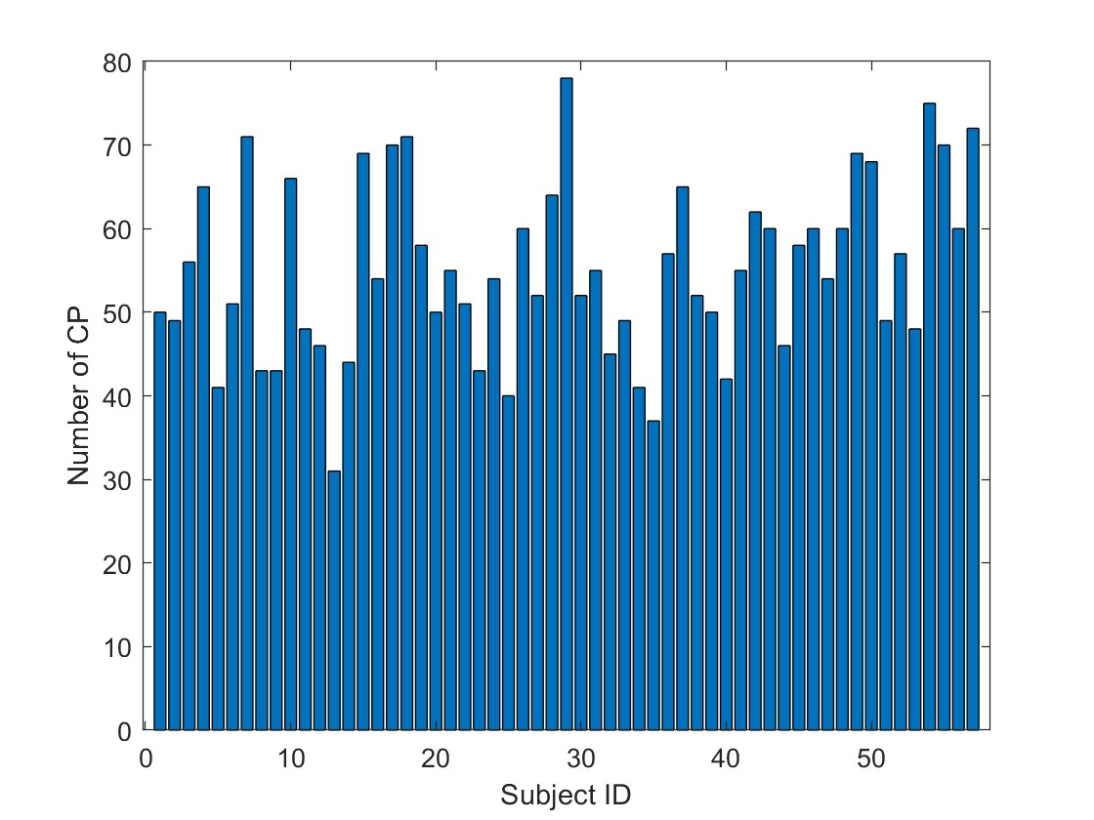
Cautious-Hist alg1 vs alg2

Slide 24
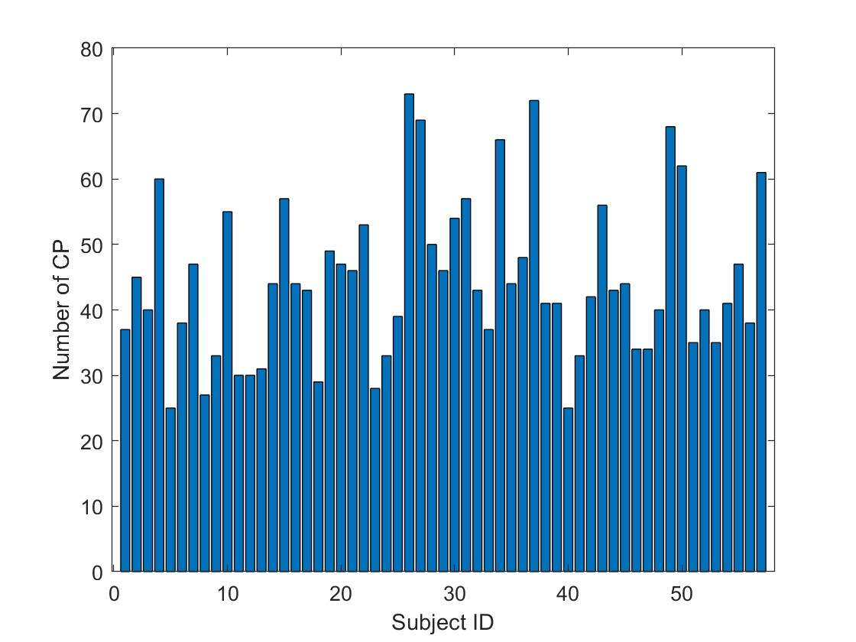
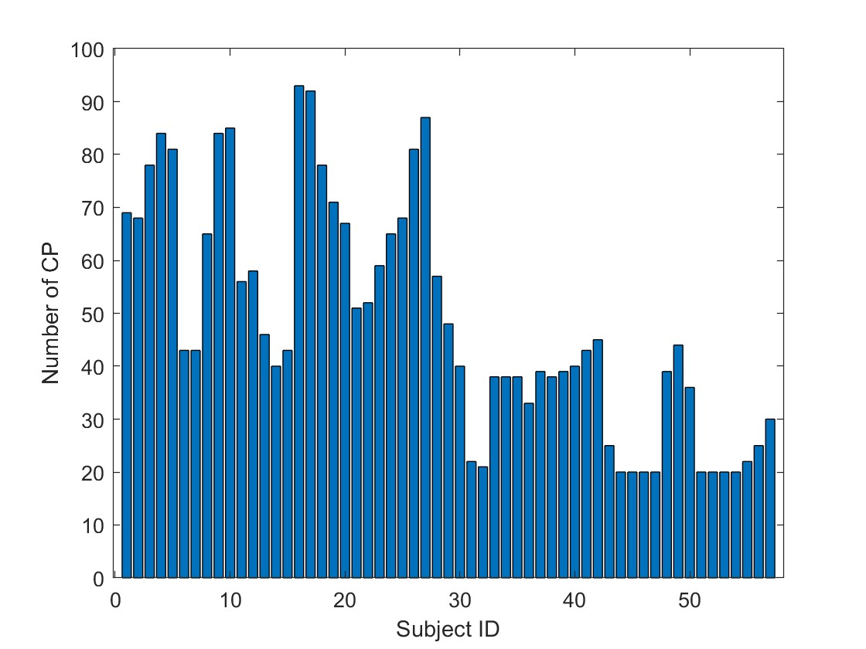
CGHBS VS ED

Slide 25
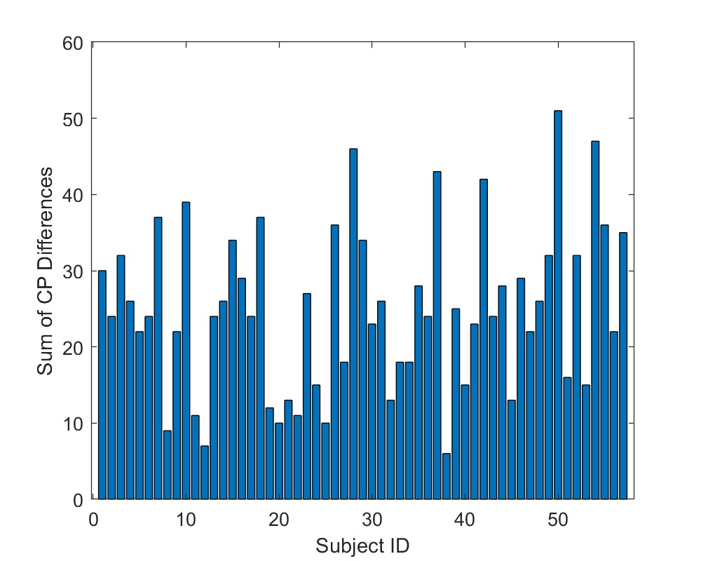
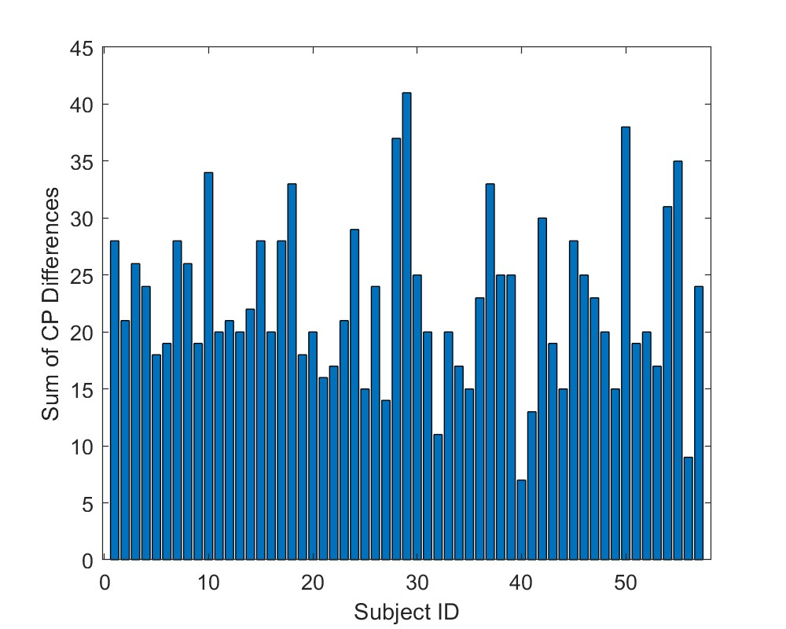
Algorithm 2 vs Algorithm 1
Cautious-Kernel
Cautious-Hist

Slide 26
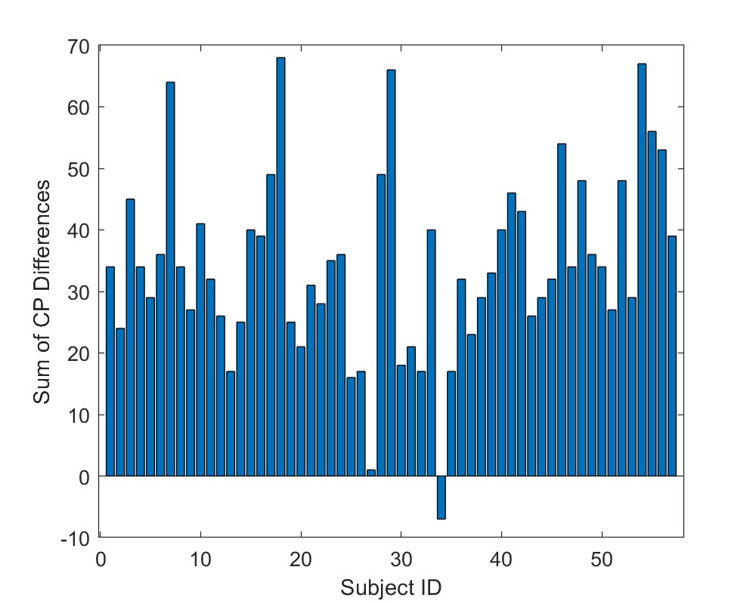
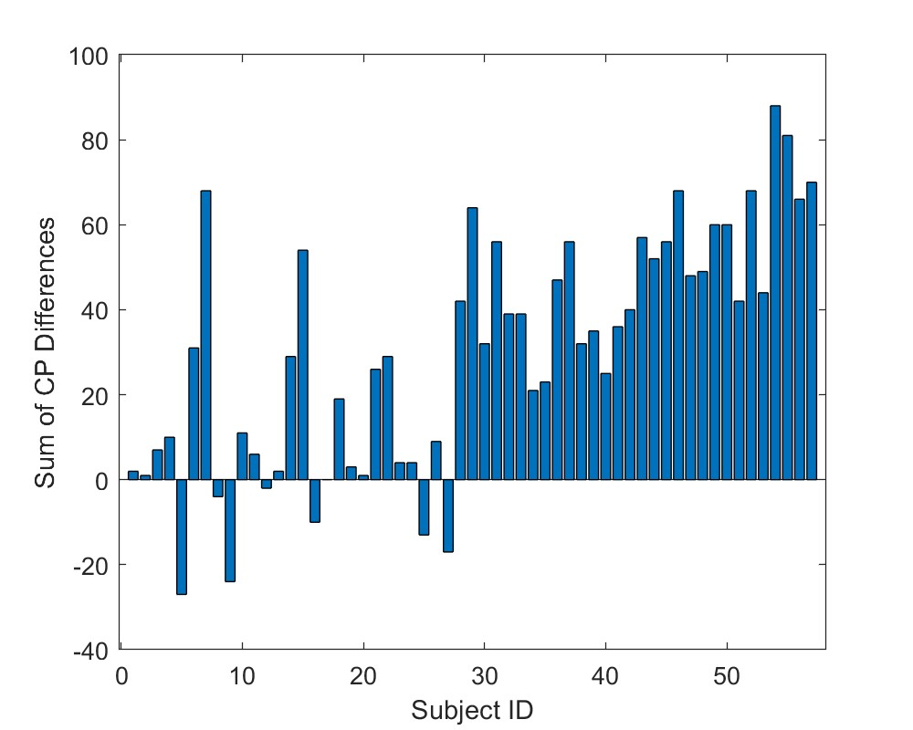
Cautious Kernel2 vs State of the art
CGHBS
ED

Slide 27
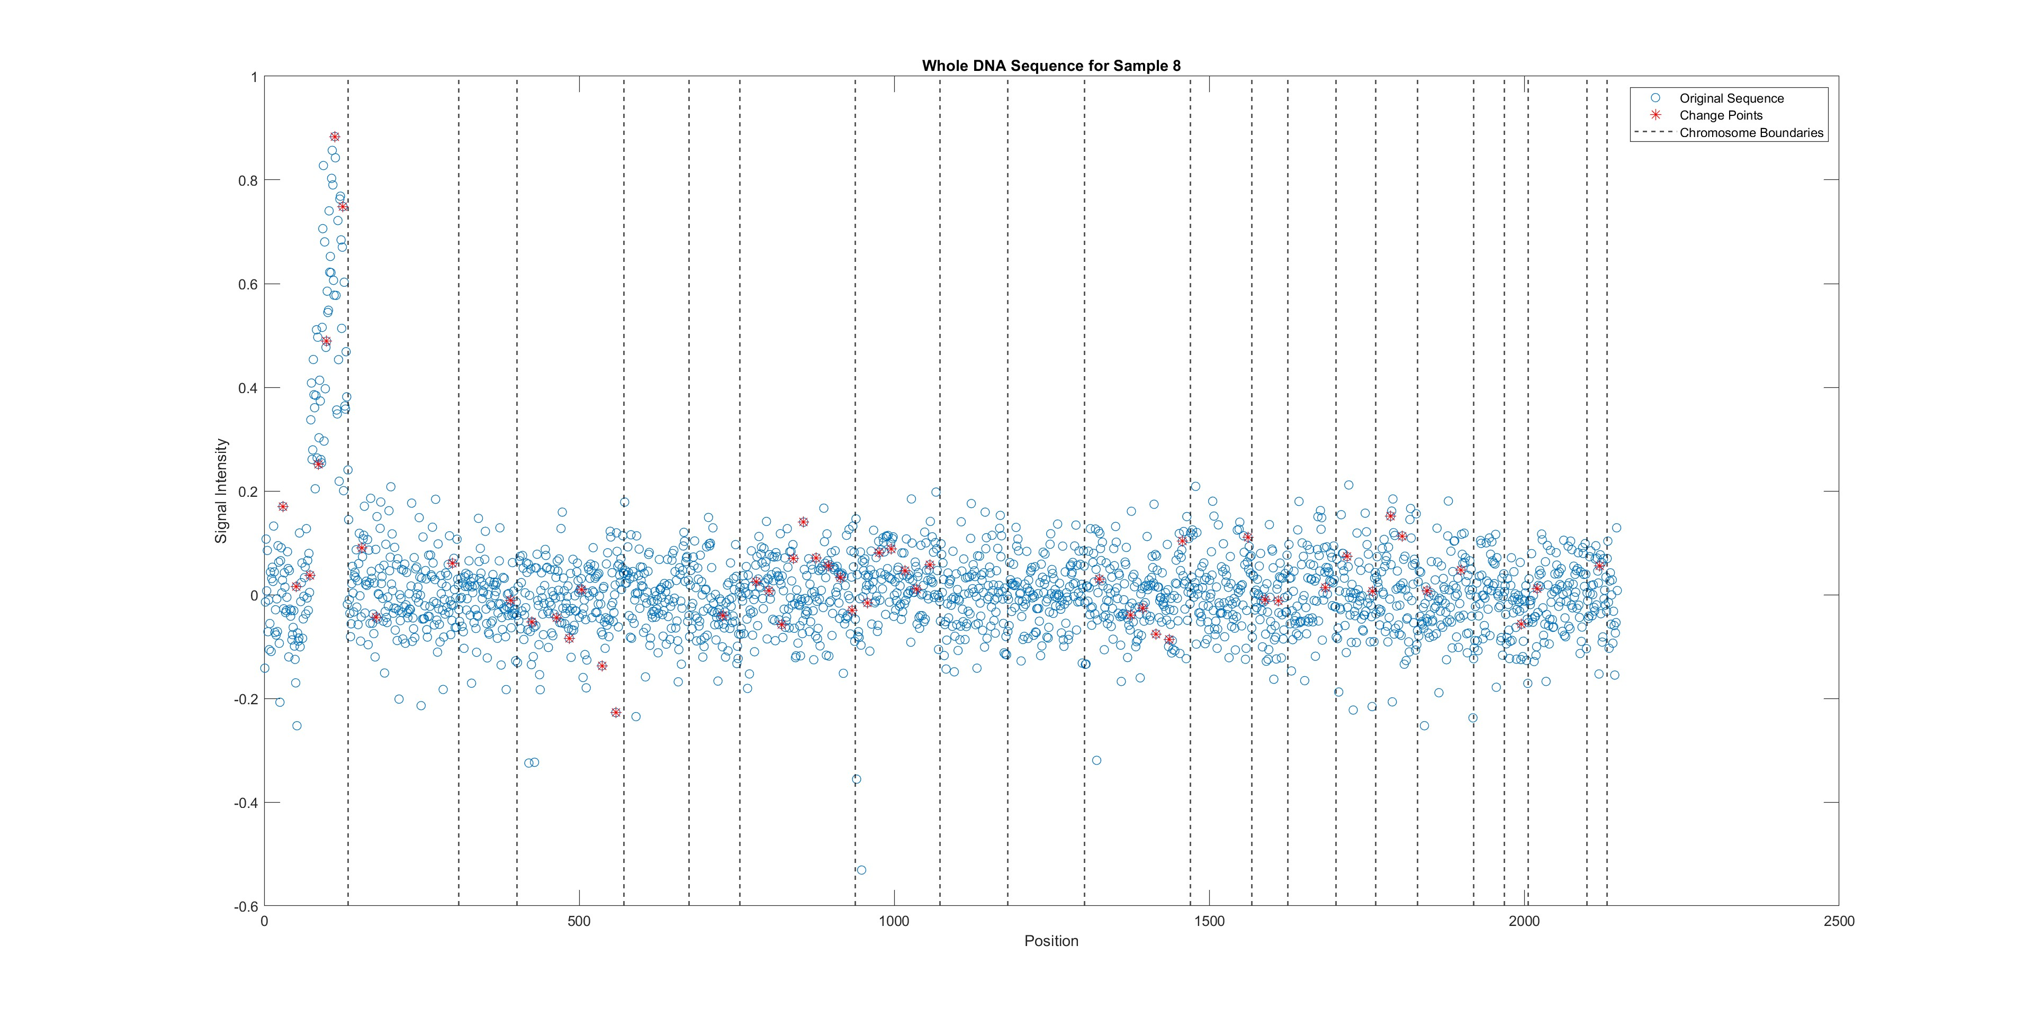

Slide 28
Conclusions
Developed two algorithms for change point (CP) detection in aCGH data.
Algorithms require only data preprocessing.
No assumptions made on specific models or distributions.
Improvements are observed when incorporating label distribution and label conditional data distribution.
Outperformed CBS and ED algorithm in the number of changes detected using the Cautious Kernel betting function.

Slide 29
Future Directions
Plan to utilize more diverse datasets
Explore combining multiple tests to enhance robustness and accuracy.

Slide 30
Thank you!!!

